Slide 1
Citizenship
Week 4
Everyone to Excel through Pride and Ambition

Slide 2
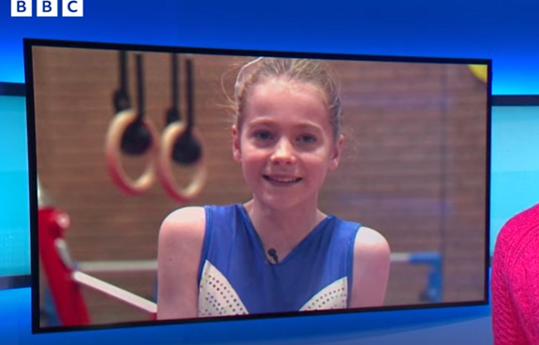
Citizenship
Inclusion
Tegan's Story | KS1 Link | https://www.youtube.com/watch?v=IDLaPbr2N34&list=PL-2SkY8uS2lJtH3yvoCPqWSf16p-LfJ7l&index=3
 | KS2 Link
 | YEAR 6 | https://www.youtube.com/watch?v=FowQGEH4Qrw

Slide 3
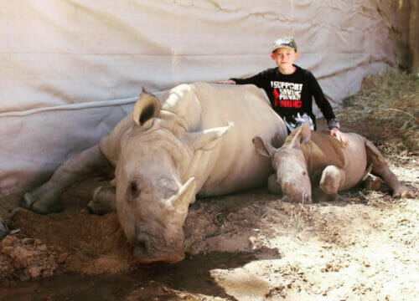
Citizenship
ECO
Hunter Mitchell – Raising funds for an orphaned rhino since he was 8 years old.
https://superkind.org/change-makers/hunter-mitchell
Notes:
Click on the link for the video and then create a short task/question based on the video.

Slide 4
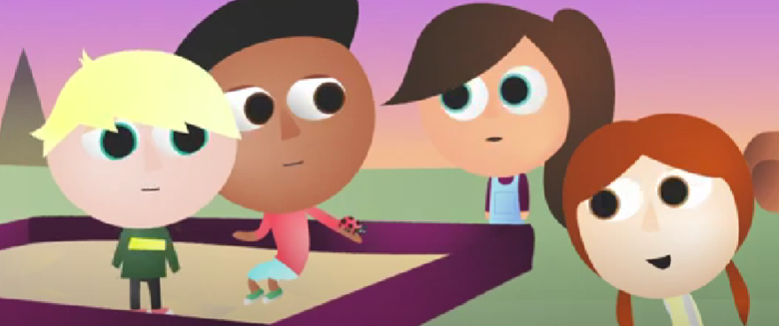
Citizenship
Safeguarding
My body | KS1 Link | https://www.youtube.com/watch?v=ujS7PZa1jgw
 | KS2 Link | https://www.youtube.com/watch?v=uAD17zMgjHc
Notes:
Click on the link for the video and then create a short task/question based on the video.

Slide 5
Citizenship
Arts
https://www.youtube.com/watch?v=Ll5SJvdaPmc
Notes:
Click on the link for the video and then create a short task/question based on the video.

Slide 6
Citizenship
Sports
https://drive.google.com/file/d/1hCLqYPaK9O7zWHESeijJJDW_Fa1An7mT/view
Notes:
Click on the link for the video and then create a short task/question based on the video.

