Slide 1
Citizenship
Week 6
Everyone to Excel through Pride and Ambition

Slide 2
Citizenship
Inclusion
https://www.youtube.com/watch?v=Ezv85LMFx2E KS1 and KS2
Notes:
Click on the link for the video and then create a short task/question based on the video.

Slide 3
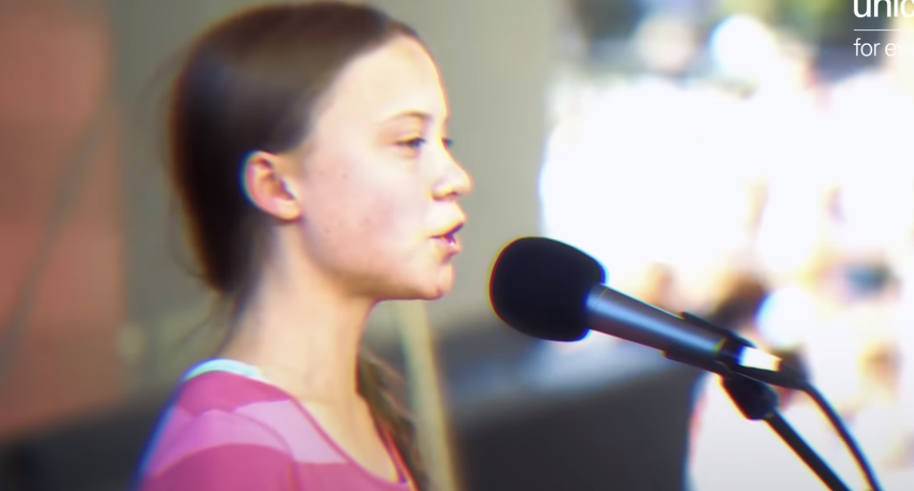
Citizenship
ECO
https://www.youtube.com/watch?v=C7dwoqJzETA
Notes:
Click on the link for the video and then create a short task/question based on the video.

Slide 4
Citizenship
Safeguarding
https://rnli.org/youth-education/education-resources/lower-primary/is-this-safe (video at the bottom called 'Going For a Walk with Teddy’) KS1
https://www.dailymotion.com/video/x83o4g2 KS2
Notes:
Click on the link for the video and then create a short task/question based on the video.

Slide 5
Citizenship
Arts
https://www.youtube.com/watch?v=LIAsTaDxUNc
Notes:
Click on the link for the video and then create a short task/question based on the video.

Slide 6
Citizenship
Sports
https://drive.google.com/file/d/1onkcPtAh8_mg5hnbDoXxepc-fD1dne7I/view?usp=drive_link
Notes:
Click on the link for the video and then create a short task/question based on the video.

