Slide 1
Citizenship
Week 7
Everyone to Excel through Pride and Ambition

Slide 2
Citizenship
Inclusion
KS1 Link | https://www.youtube.com/watch?v=11r7CFlK2sc
KS2 Link
Notes:
Click on the link for the video and then create a short task/question based on the video.

Slide 3
Citizenship
ECO
Water Saving Tips and Tricks - Let's Save the Planet - The Environment for Kids - YouTube
Notes:
Click on the link for the video and then create a short task/question based on the video.

Slide 4
Citizenship
Safeguarding
KS1 Link | https://www.bbc.co.uk/teach/class-clips-video/pshe-eyfs-ks1-feeling-worried/zb6ngwx
KS2 Link | https://www.bbc.com/ownit/its-personal/when-you-see-something-scary-online
Notes:
Click on the link for the video and then create a short task/question based on the video.

Slide 5
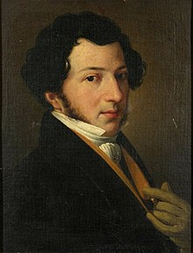
Citizenship
Arts
Rossini (play from around 6min to the end)
https://www.youtube.com/watch?v=BGo2eiy0VcE
Notes:
Click on the link for the video and then create a short task/question based on the video.

Slide 6
Citizenship
Sports
https://www.youtube.com/watch?v=_gJ5V525SCk
5 ways to wellbeing
Notes:
Click on the link for the video and then create a short task/question based on the video.

