Slide 1
Citizenship
Week 4
Everyone to Excel through Pride and Ambition

Slide 2
Citizenship
Inclusion
KS1 Link | https://www.youtube.com/watch?v=KlqQoDGFDbc&list=PLAoW1zMlmOlllX2J2TJorsGpWW5nlTgzA&index=1
KS2 Link
Notes:
Click on the link for the video and then create a short task/question based on the video.

Slide 3
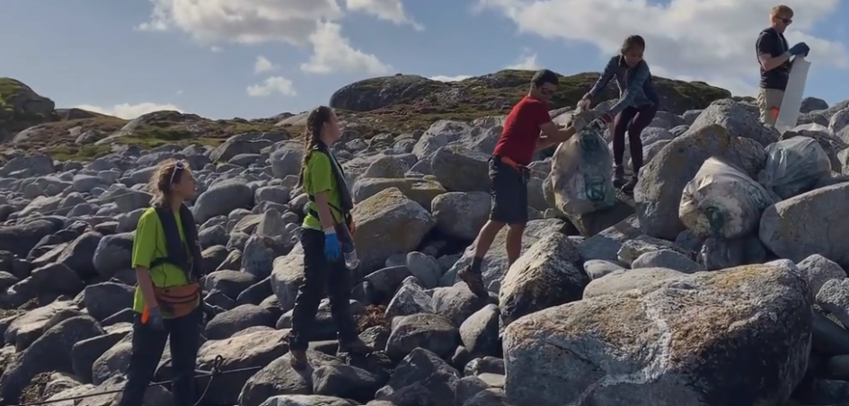
Citizenship
ECO
Trash Island Timelapse - YouTube
Notes:
Click on the link for the video and then create a short task/question based on the video.

Slide 4
Citizenship
Safeguarding
KS1 Link | https://www.youtube.com/watch?v=u03EHVf-7vI
KS2 Link
Notes:
Click on the link for the video and then create a short task/question based on the video.

Slide 5
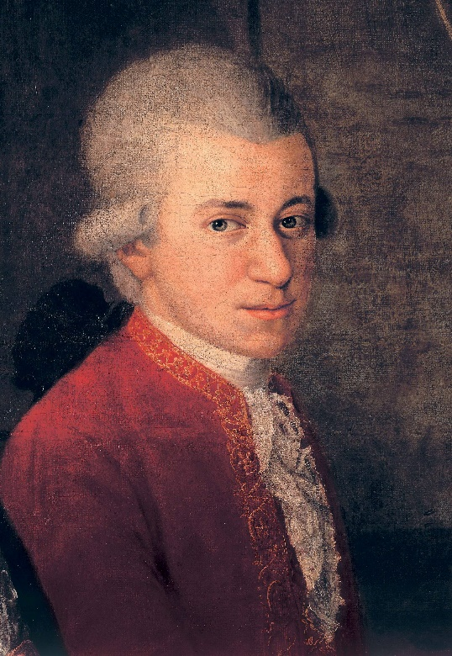
Citizenship
Arts
Mozart
https://www.youtube.com/watch?v=N1cexwLOvtY
Notes:
Click on the link for the video and then create a short task/question based on the video.

Slide 6
Citizenship
Sports
https://drive.google.com/file/d/1xtWSi1NGZYaEXvcY3oUqc99Cmkc3I0U1/view?usp=drive_link
Notes:
Click on the link for the video and then create a short task/question based on the video.

