Slide 1
Citizenship
Week 4
Everyone to Excel through Pride and Ambition

Slide 2
Citizenship
Inclusion
Down Syndrome | KS1 Link | https://www.youtube.com/watch?v=_r_2rmDYfz4
 | KS2 Link
Notes:
Click on the link for the video and then create a short task/question based on the video.

Slide 3
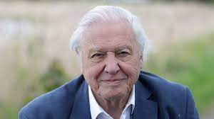
Citizenship
ECO
https://youtu.be/b6Ua_zWDH6U?si=HVJMq-dXezRJCiQw
Notes:
Click on the link for the video and then create a short task/question based on the video.

Slide 4
Citizenship
Safeguarding
Fire Safety | KS1 Link | https://www.youtube.com/watch?v=S9Uky6wacwI
 | KS2 Link
Notes:
Click on the link for the video and then create a short task/question based on the video.

Slide 5
Citizenship
Arts
https://www.youtube.com/watch?v=nancM790QnQ&t=22s
Notes:
Click on the link for the video and then create a short task/question based on the video.

Slide 6
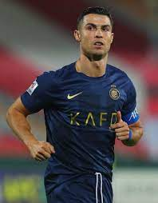
Citizenship
Sports
https://www.youtube.com/watch?v=9bn7fd1RZl4
Notes:
Click on the link for the video and then create a short task/question based on the video.

