Slide 1





Citizenship
Week 3
Everyone to Excel through Pride and Ambition

Slide 2


Citizenship
Inclusion
Braille | KS1 Link | https://www.youtube.com/watch?v=o9BOQ6IpTSE
 | KS2 Link
Notes:
Click on the link for the video and then create a short task/question based on the video.

Slide 3


Citizenship
ECO
https://youtu.be/Z7GCYG9YeT8?feature=shared
Notes:
Click on the link for the video and then create a short task/question based on the video.

Slide 4


Citizenship
Safeguarding
Online Safety | KS1 Link | https://www.youtube.com/watch?app=desktop&v=bv8AGkZHYJQ&feature=youtu.be
 | KS2 Link | https://www.youtube.com/watch?app=desktop&v=bv8AGkZHYJQ&feature=youtu.be (same as KS1 to suit lower KS2)
Notes:
Click on the link for the video and then create a short task/question based on the video.

Slide 5
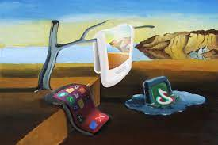

Citizenship
Arts
https://www.youtube.com/watch?v=1YE_Zas-A5A
Notes:
Click on the link for the video and then create a short task/question based on the video.

Slide 6

Citizenship
https://www.youtube.com/watch?v=VtQ9x6rKvoY
Everyone to Excel through Pride and Ambition

