Slide 1
Citizenship
Week 5
Everyone to Excel through Pride and Ambition

Slide 2
Citizenship
Inclusion
BSL (Deaf Awareness Wk 6-12 May)
https://www.youtube.com/watch?v=YtAi0R83qzU 00:00- 05:00 (please encourage your children to have a go at the signs themselves)

Slide 3
Citizenship
ECO
Danielle Gram - Unifying children to work together towards world peace
https://superkind.org/change-makers/danielle-gram
Notes:
Click on the link for the video and then create a short task/question based on the video.

Slide 4
Citizenship
Safeguarding
Safety around Electricity
https://www.youtube.com/watch?v=r-QK20pZvto&t=6s
beginning - 4minutes (reiterate that the number to call is 999 not 911)
Notes:
Click on the link for the video and then create a short task/question based on the video.

Slide 5
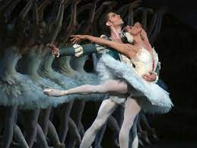
Citizenship
Arts
https://www.youtube.com/watch?v=2bUvIiv2RZQ
Notes:
Click on the link for the video and then create a short task/question based on the video.

Slide 6
Citizenship
Sports
The Power of Positivity
https://www.youtube.com/watch?v=kO1kgl0p-Hw&t=59s
Notes:
Click on the link for the video and then create a short task/question based on the video.

