Slide 1
Citizenship
Week 5
Everyone to Excel through Pride and Ambition

Slide 2
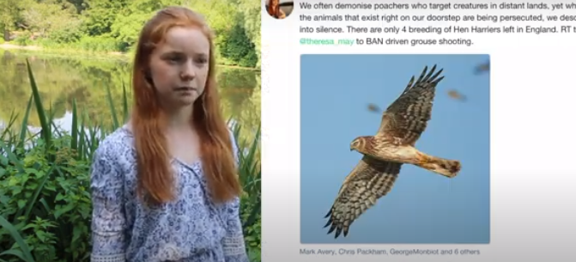
Citizenship
ECO
Bella Lack – Campaigning for the Protection of Nature
https://superkind.org/change-makers/bella-lack
Notes:
Click on the link for the video and then create a short task/question based on the video.

Slide 3
Citizenship
Safeguarding
Online Safety | KS1 Link | https://www.youtube.com/watch?app=desktop&v=d5kW4pI_VQw
 | KS2 Link | https://www.youtube.com/watch?app=desktop&v=yiKeLOKc1tw
Notes:
Click on the link for the video and then create a short task/question based on the video.

Slide 4
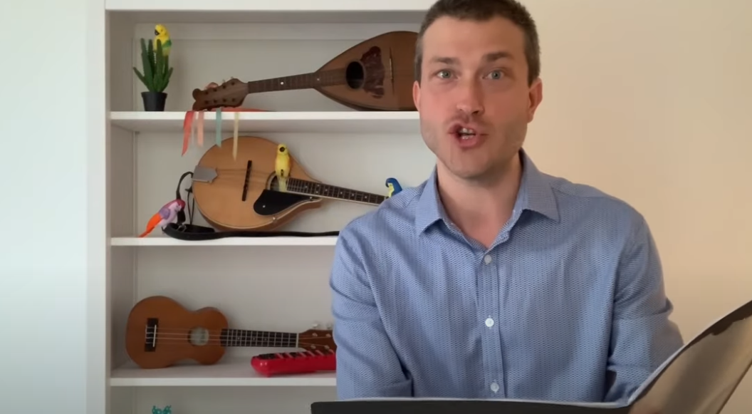
Citizenship
Arts
https://www.youtube.com/watch?v=VO0whvQ3QJA
Watch 20-25
Notes:
Click on the link for the video and then create a short task/question based on the video.

Slide 5
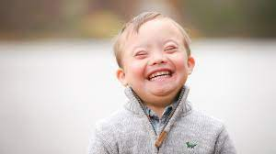
Citizenship
Inclusion
Down Syndrome Day
21st March 2024
https://www.youtube.com/watch?v=fZIZRJiTjOw

Slide 6
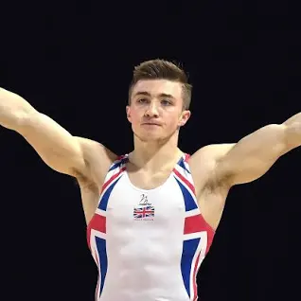
Citizenship
Sports
Sam Oldham – Gymnast
https://www.youtube.com/watch?v=y4wlIPICCCk&list=PLcvEcrsF_9zLiSsK0i03cYRbzLhVRIfQE&index=4
Notes:
Click on the link for the video and then create a short task/question based on the video.

