Slide 1
Citizenship
Week 1
Everyone to Excel through Pride and Ambition

Slide 2
Citizenship
Inclusion
KS1 Link | https://www.youtube.com/watch?v=PW2duKZChA8
KS2 Link
Notes:
Click on the link for the video and then create a short task/question based on the video.

Slide 3
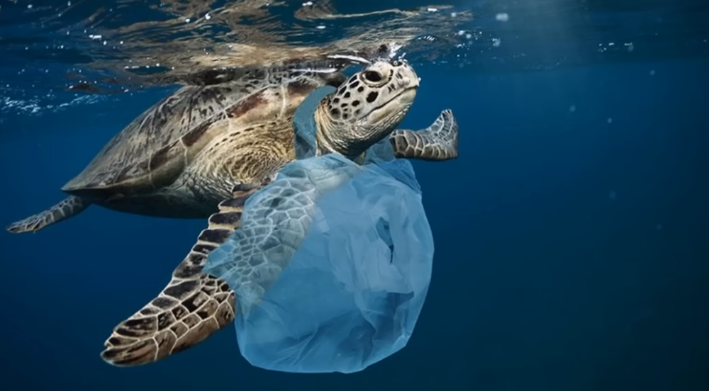
Citizenship
ECO
How to Take Care of the Environment (Learning Videos For Kids) - YouTube
Notes:
Click on the link for the video and then create a short task/question based on the video.

Slide 4
Citizenship
Safeguarding
KS1 Link | https://www.youtube.com/watch?v=NwwdYWPu4n0
KS2 Link | https://www.think.gov.uk/resource/expect-the-unexpected/
Notes:
Click on the link for the video and then create a short task/question based on the video.

Slide 5
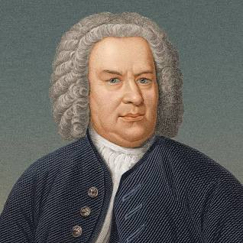
Citizenship
Arts
Bach
https://www.youtube.com/watch?v=lJahQRJ0Tq8
Notes:
Click on the link for the video and then create a short task/question based on the video.

Slide 6
Citizenship
Sports
https://drive.google.com/file/d/1UtGE94AK3KXxzAYNqVNX1qRegICGQFb4/view?usp=drive_link
Notes:
Click on the link for the video and then create a short task/question based on the video.

