Slide 1
Citizenship
Week 4
Everyone to Excel through Pride and Ambition

Slide 2
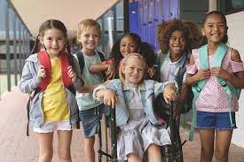
Citizenship
Inclusion
https://www.youtube.com/watch?v=JafGv2IDnZU&list=PL-2SkY8uS2lJtH3yvoCPqWSf16p-LfJ7l&index=5

Slide 3
Citizenship
ECO
Autumn Peltier – Campaigning for Clean Drinking Water for Everyone
https://superkind.org/change-makers/autumn-peltier
Notes:
Click on the link for the video and then create a short task/question based on the video.

Slide 4
Citizenship
Safeguarding
Online Safety | KS1 Link | https://undressed.lgfl.net/?utm_campaign=DigiSafe&utm_medium=email&_hsmi=235690873&_hsenc=p2ANqtz--5TbXJ9UxX5R8cxmiijemmiwOf7kktJh3dF-AuuOZ6wULRZ0cmGYwoL7vLZ_z5jcfEjbmNXM40lkq6lsC27l5C37GHHudqPyF1YmuA5q4SueQRaZ4&utm_content=235690873&utm_source=hs_email
 | KS2 Link | https://www.youtube.com/watch?v=GAXBz5kC3CQ
Notes:
Click on the link for the video and then create a short task/question based on the video.

Slide 5
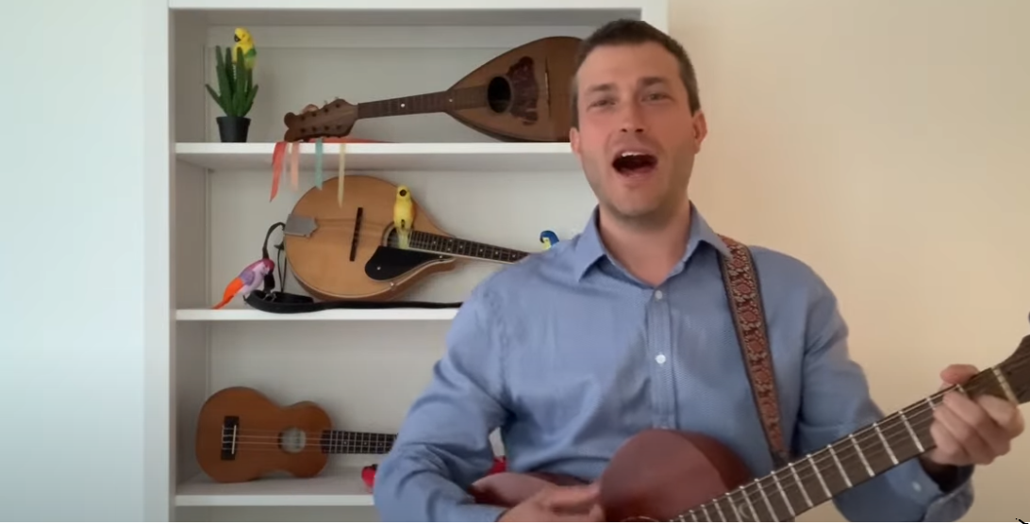
Citizenship
Arts
https://www.youtube.com/watch?v=VO0whvQ3QJA
Watch 15-20
Notes:
Click on the link for the video and then create a short task/question based on the video.

Slide 6
Citizenship
Sports
Christine Ohuruogo – Female Olympic Athlete
https://www.youtube.com/watch?v=xqVfsxty7rY&list=PLcvEcrsF_9zLlY-veAxOZoDoVj_es-AOR&index=2
Notes:
Click on the link for the video and then create a short task/question based on the video.

