Slide 1
Citizenship
Week 2
Everyone to Excel through Pride and Ambition

Slide 2
Citizenship
Inclusion
Scoliosis
 | https://www.youtube.com/watch?v=IDLaPbr2N34&list=PL-2SkY8uS2lJtH3yvoCPqWSf16p-LfJ7l&index=3

Slide 3
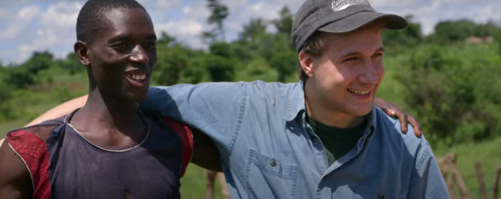
Citizenship
ECO
The Ryan’s Well Foundation
https://superkind.org/change-makers/ryan-hreljac
Notes:
Click on the link for the video and then create a short task/question based on the video.

Slide 4
Citizenship
Safeguarding
https://www.youtube.com/watch?app=desktop&v=CNxNIsQ_SzY (up to 7 minutes)
Notes:
Click on the link for the video and then create a short task/question based on the video.

Slide 5
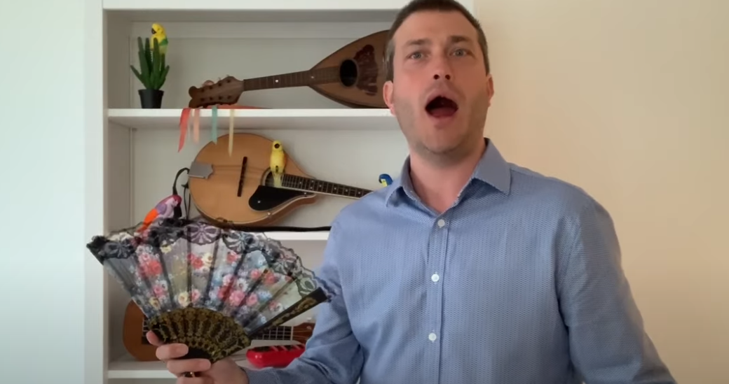
Citizenship
Arts
https://www.youtube.com/watch?v=VO0whvQ3QJA
Watch 5-10 minutes
Notes:
Click on the link for the video and then create a short task/question based on the video.

Slide 6
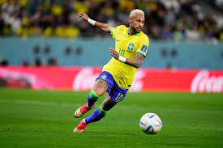
Citizenship
Sports
Motivational Success Story Of Neymar - How The Poor Boy Became The Most Expensive Football Player
https://www.youtube.com/watch?v=fb1vtJM96Rg
Notes:
Click on the link for the video and then create a short task/question based on the video.

