Slide 1
Citizenship
Week 2
Everyone to Excel through Pride and Ambition

Slide 2
Citizenship
ECO
World Earth Day 2024
https://www.youtube.com/watch?v=45G6ERKLXvI
Notes:
Click on the link for the video and then create a short task/question based on the video.

Slide 3
Citizenship
Inclusion
Kindness KS1 Link https://www.youtube.com/watch?v=VApeQZWZVQw
KS2 Link https://www.youtube.com/watch?v=bs7f1hTmIAQ

Slide 4
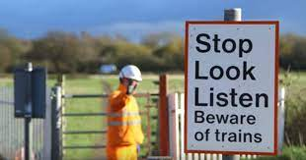
Citizenship
Safeguarding
Rail Safety | KS1 Link | https://learnliveuk.com/ks1-primary-school-safety-talk/ (input bkershawma@theparkfederation.org to access)
 | KS2 Link | https://learnliveuk.com/network-rail-primary-school-safety-talk YEARS 3 AND 4 START AT 2:45 (input bkershawma@theparkfederation.org to access)
Notes:
Click on the link for the video and then create a short task/question based on the video.

Slide 5
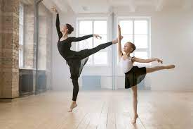
Citizenship
Arts
https://www.youtube.com/watch?v=fyKRJyIIzX8
Notes:
Click on the link for the video and then create a short task/question based on the video.

Slide 6
Citizenship
Sports
Samantha Murray
https://www.youtube.com/watch?v=Tmtz2DOzg3s&list=PLcvEcrsF_9zLiSsK0i03cYRbzLhVRIfQE&index=5
Notes:
Click on the link for the video and then create a short task/question based on the video.

