Slide 1
Citizenship
Week 3
Everyone to Excel through Pride and Ambition

Slide 2
Citizenship
Inclusion
KS1 Link | https://www.youtube.com/watch?v=KlqQoDGFDbc&list=PLAoW1zMlmOlllX2J2TJorsGpWW5nlTgzA&index=1
KS2 Link
Notes:
Click on the link for the video and then create a short task/question based on the video.

Slide 3
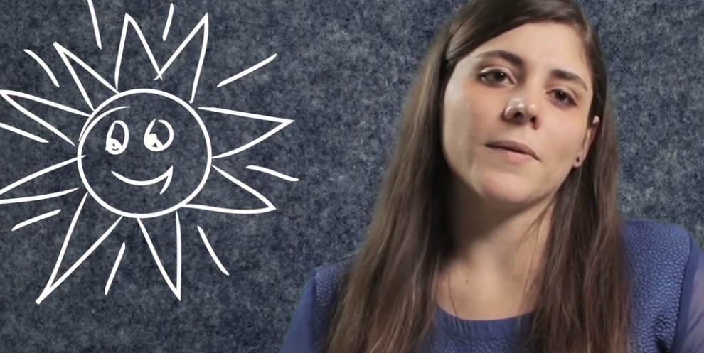
Citizenship
ECO
Sustainable House Project for Kids | #EarthMonth Activity Series - YouTube
Notes:
Click on the link for the video and then create a short task/question based on the video.

Slide 4
Citizenship
Safeguarding
KS1 Link | https://www.bbc.co.uk/teach/class-clips-video/science-ks1-keeping-my-body-healthy/zk4dwty
KS2 Link | https://www.youtube.com/watch?v=dhpCdqOtuj0
Notes:
Click on the link for the video and then create a short task/question based on the video.

Slide 5
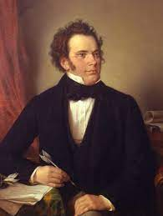
Citizenship
Arts
Shubert
https://www.youtube.com/watch?v=HwbWvGtaZGo
Notes:
Click on the link for the video and then create a short task/question based on the video.

Slide 6
Citizenship
Sports
https://drive.google.com/file/d/1GnGefldPUEdAc1D1Yg0dGc5aM-KsL767/view?usp=drive_link
Notes:
Click on the link for the video and then create a short task/question based on the video.

