Slide 1
Citizenship
Week 4
Everyone to Excel through Pride and Ambition

Slide 2
Citizenship
ECO
Frasier Cox – Wrote a children’s book about refugees and proceeds support Save The Children charity.
https://superkind.org/change-makers/frasier-cox
Notes:
Click on the link for the video and then create a short task/question based on the video.

Slide 3
Citizenship
World Day for Cultural Diversity
21st May 2024
https://www.youtube.com/watch?v=SyaLcfMeeEM

Slide 4
Citizenship
Safeguarding
Safety around Electricity
https://www.youtube.com/watch?v=r-QK20pZvto&t=6s 4 minutes - end (reiterate that the number to call is 999 not 911)
Notes:
Click on the link for the video and then create a short task/question based on the video.

Slide 5
Citizenship
Arts
https://www.youtube.com/watch?v=HdheoI6Anug (watch half)
Notes:
Click on the link for the video and then create a short task/question based on the video.

Slide 6
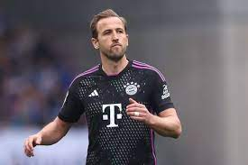
Citizenship
Sports
Harry Kane - Resilience
https://www.youtube.com/watch?v=a7MmCj3liMs
Notes:
Click on the link for the video and then create a short task/question based on the video.

